Slide 1
Function Hall Management Rajesh Settipalli ID : 349496
By using this app we can book function halls easily by selecting state and city.

Slide 2
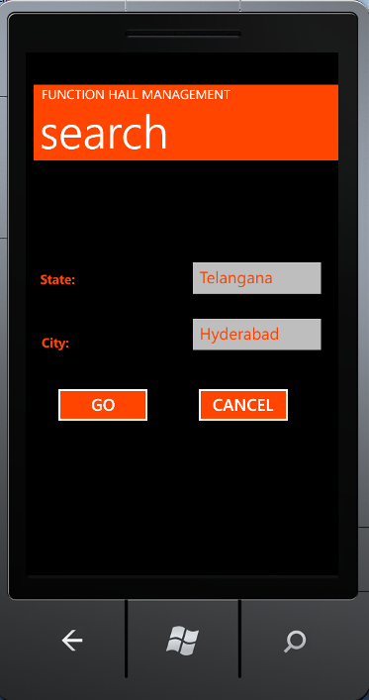
Search Page: select state and city and click on GO button.

Slide 3
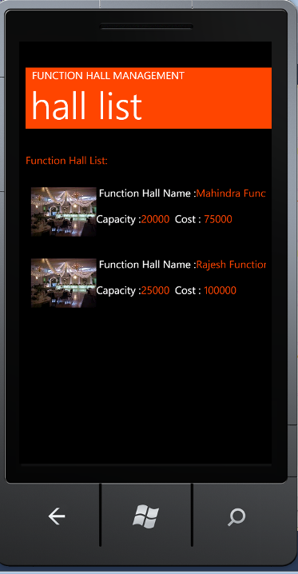
Function Hall List: this page displays all the function halls list based on state and city

Slide 4
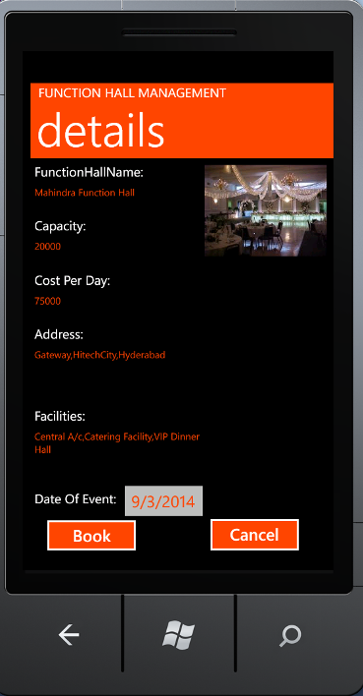
Details: This page displays all the details of selected function hall

Slide 5
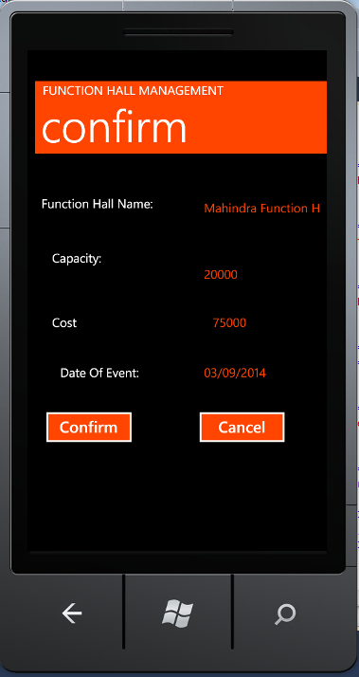
Confirmation: this page will ask for confirmation

Slide 6
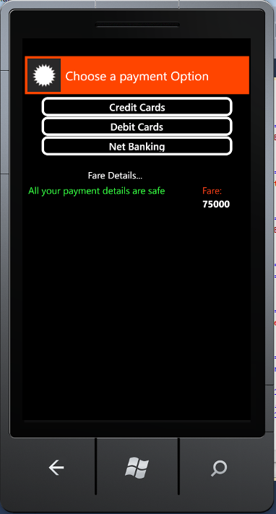
Payment Page:

Slide 7
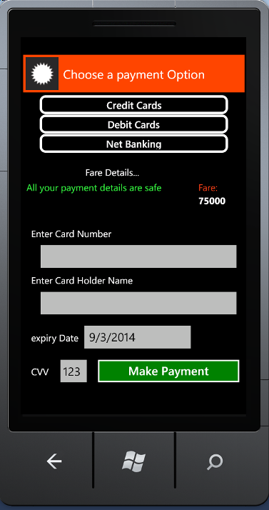
Credit/Debit Card Payment:

Slide 8
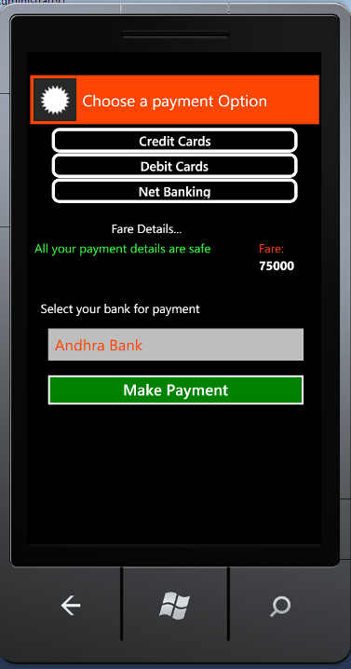
Internet Banking Payment

